Slide 1

role of ai in cardiopulmonary bypass: A Systemic Review
Presented by: Muhammad Hassam
Supervised by: Miss Wadiha Waheed
KMU IHS Islamabad

Slide 2
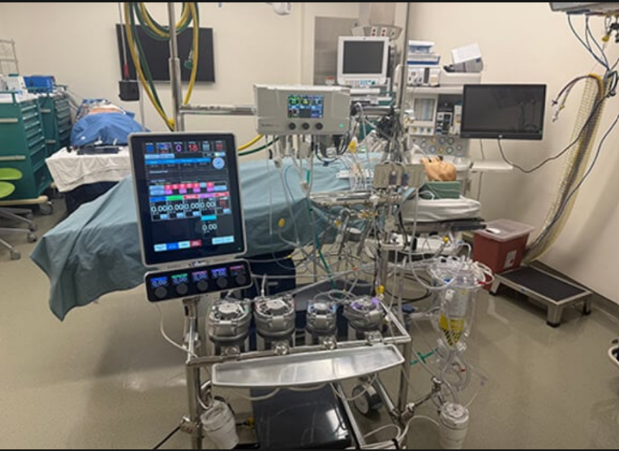
Introduction:
Cardiopulmonary Bypass (CPB) is a life-saving mechanical innovation that has reached a cognitive limit due to modern complexity.
Replaces heart and lung functions using pump, oxygenator, and heat exchanger
Historically a manual process where the perfusionist adjusts flow
Modern procedures generate hundreds of evolving physiological parameters every second (1-Hz) [Dias et al., 2022]
Despite having vast amounts of high-frequency data, we lack integrated, automated systems to provide predictive support. [Natarajan et al., 2025]

Slide 3
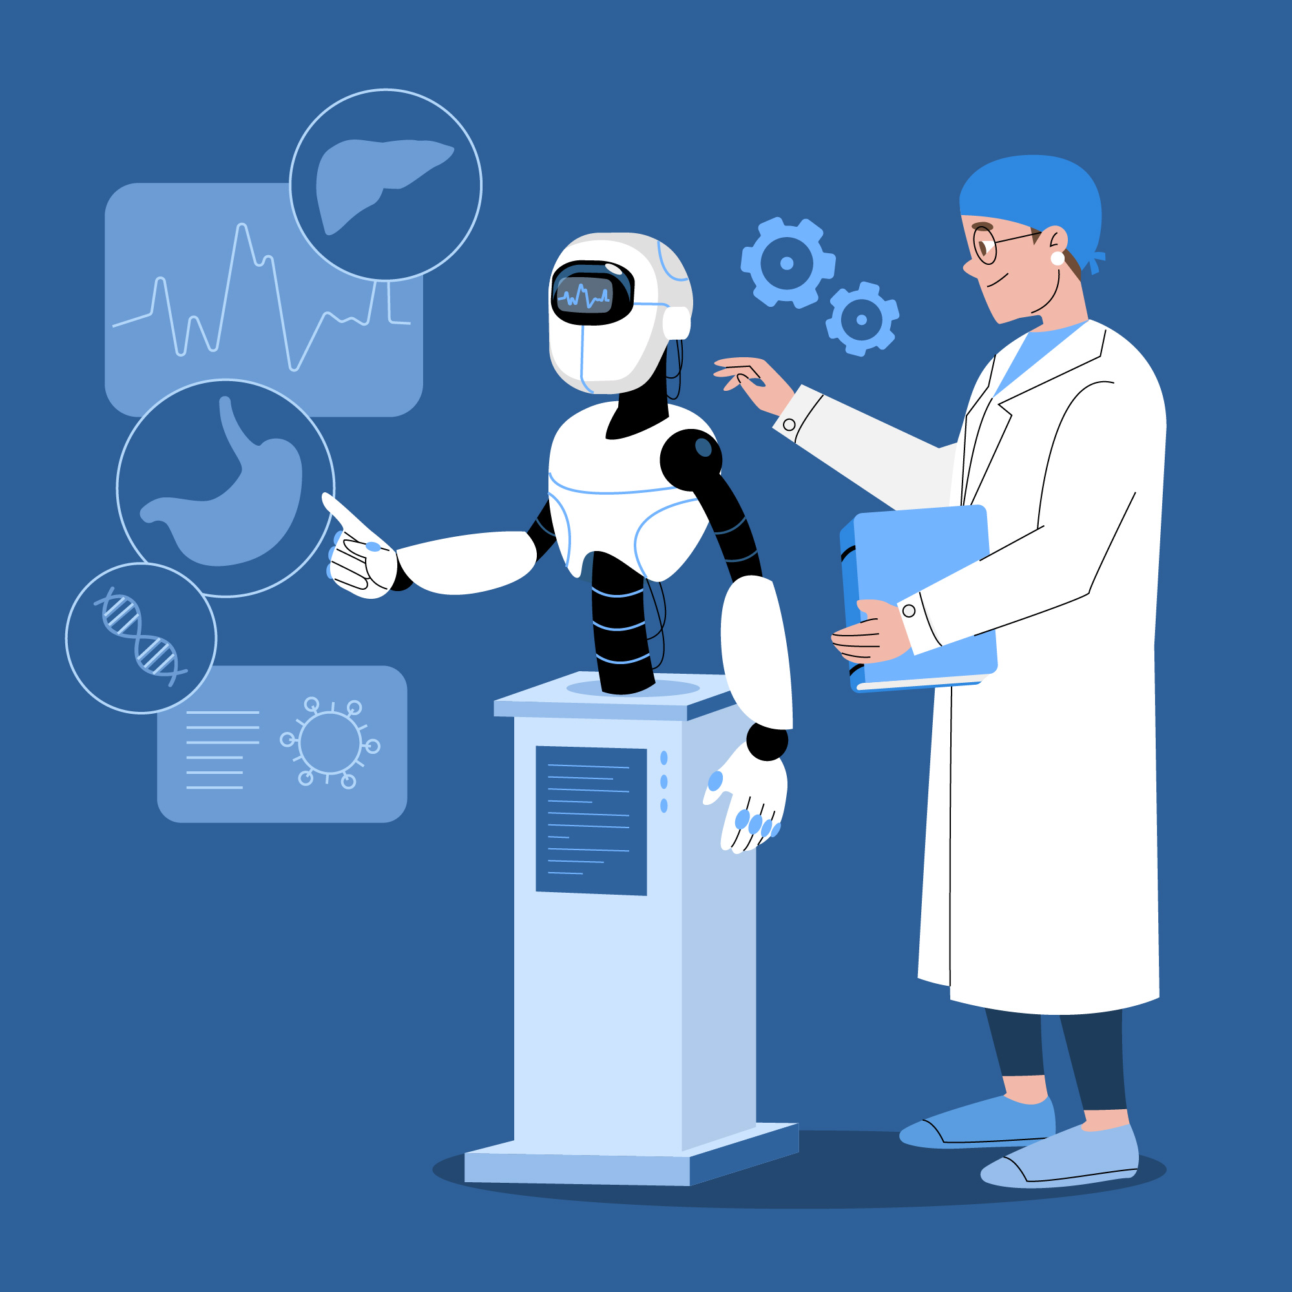
The Technological Crossroads (The KFSHRC Paradigm)
The team at KFSHRC performed the world’s first fully robotic heart transplant on a 16-year-old.
The success of fully robotic surgery proves that AI-supported operating room is the new "Gold Standard" for safety.
By using a robotic platform (Da Vinci), surgical and perfusionist actions are transformed into digital data that AI can analyze.
This program achieved a 98% survival rate, proving that "AI in the loop" is a clinical necessity for managing cases.
Notes:
Moving from a "guess-and-check" methodology to a proactive "predict-and-prevent" standard of care through human-AI collaboration.

Slide 4
Literature Review:
Source | Focus Area | Findings | Clinical Value
KFSHRC (2024) | Robotic Heart Transplant | 98% Survival Rate | Proof of concept for a digitized, high-precision OR.
Constable et al. (2024) | Computer Vision in the OT | 93% Action Recognition | AI as a "second set of eyes" for procedural safety.
Natarajan et al. (2025) | Hemodynamic Control | 2.6% RMSE in pump flow | Superior technical precision over manual titration.
Lee et al. (2021) | Outcome Prediction (AKI) | AUC 0.89 for renal risk | Identifies "AKI-prone states" before creatinine rises.
Alexander et al.(2024) | AI-Human Interaction | "Invaluable Adjunct" | AI empowers rather than replaces the perfusionist.
Kobayashi Y et al (2023) | Metabolic Forecasting | Mean Absolute Error (MAE) of 0.12 mmol/L | Predicts metabolic distress 20 mins in advance.

Slide 5

Research Gap:
The fundamental research gap is a lack of integration.
Modern CPB consoles generate 1-Hz high-frequency data, yet clinical decisions are still based on "snapshots" taken every 15–30 minutes.
It is physically impossible for a human to track and correlate 50+ variables every second while maintaining focus on the surgical field
The Spectrum Medical Quantum records every single second of the surgery (1-Hz data). That is 3,600 data points every hour.
Notes:
The "Quantum" Example: "To illustrate this gap, look at the Spectrum Medical Quantum. It is a masterpiece of engineering. Its Viper EMR and Vision Server can record every heartbeat and pump rotation at a 1-Hz frequency. The data is there."

Slide 6
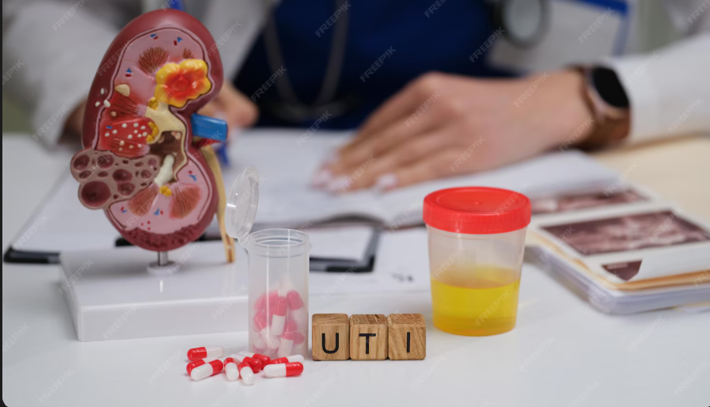
Rationale and Significance
Transitioning from "Manual Safety" to "Predictive Precision" to eliminate avoidable surgical complications.
Problems like Acute Kidney Injury (AKI) are often detected only after the damage is done (via rising creatinine levels).
AI models (like CatBoost) can predict AKI with 89% accuracy (0.89 AUC) up to 20 minutes before it happens, allowing for life-saving adjustments to pump flow and oxygen delivery (DO2). (Lee et al. (2021))
Notes:
"The significance isn't just about 'better math.' It’s about human endurance. We are using the 1-Hz data from the Quantum to act as a second set of eyes that never gets tired, never blinks, and can see a complication coming before it even hits the patient."

Slide 7

Objectives
Synchronize High-Frequency Data:
To integrate the 1-Hz data stream from the Quantum’s Viper EMR (Flow, Pressure, SvO2, Hb) into a real-time AI processing layer.
Develop Action Recognition:
To build a model that recognizes surgical maneuvers (e.g., cross-clamping) with >90% accuracy, reducing false alarms and "alarm fatigue.
Predictive Complication Forecasting:
To utilize machine learning (CatBoost/RNNs) to predict Acute Kidney Injury (AKI) and Lactate spikes with a 20-minute lead time.

Slide 8

Methodology
Data Source:
High-frequency time-series data from Spectrum Medical Quantum.
Machine Data includes; Pump Flow (RPM), Line Pressures, Reservoir levels, Patient SvO2, Hb, Arterial/Venous Temperatures, MAP.
Over 14,400 data points per variable for a standard 4-hour case.
The AI Engine:
Splitting data into three specialized models (Cognitive, Physiologic, Clinical).

Slide 9
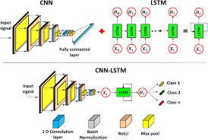
Action Recognition:
Teaching the machine to "see" and "understand" the surgery.
Architecture: CNN-LSTM Hybrid (Convolutional + Long Short-Term Memory).
CNN extracts features from the surgical environment/data patterns.
LSTM provides "memory," allowing the AI to understand the sequence of steps.
Reach >90% accuracy in identifying key maneuvers (e.g., Aortic Cross-Clamping)
Source: Constable et al. (2024). "Deep Learning for Action Recognition in Cardiac Surgery."

Slide 10
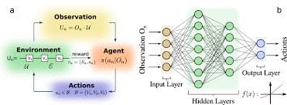
Heamodynamic Stability:
Using "Feedback Loops" to match expert pump management.
The Engine: Reinforcement Learning (RL).
AI controlling the pump. Using the patient’s physiological state (Blood pressure, Hb,SvO2).
AI is "rewarded" for maintaining the patient within optimal physiological zones.
Research shows the AI achieved a 2.6% Error
Source: Natarajan et al. (2025). "Autonomous Hemodynamic Management in CPB."
Notes:
The AI is trained specifically to automate GDP. While a human might wait for a 15-minute blood gas to see if oxygen delivery is low, the RL agent is calculating every second and adjusting the pump speed (RPM) or the blender settings instantly to maintain the target.

Slide 11
Prediction:
The Goal: Forecast Acute Kidney Injury (AKI) and Lactate Spikes.
Predicting the future to protect the organs.
Architecture: CatBoost & Recurrent Neural Networks (RNNs).
The goal is to predict Acute kidney Injury (AKI) and Lactate Spikes.
AKI is complex and depends on many "static" factors (patient age, weight, pre-op health) combined with "dynamic" bypass data. CatBoost is world-class at handling these mixed data types to find the hidden risk.
Lactate is a "time-series" problem it moves in waves. RNNs are designed to have a "memory," so they can look at the last 30 minutes of 1-Hz data and predict where the lactate level will be in the next 20 minutes.
Sources; Lee, et al. (2021). Machine Learning for Predictive Analytics of Acute Kidney Injury in Cardiac Surgery: A Gradient Boosting Approach.

Slide 12

Trust through ‘explainable ai:
Why should we trust the AI? Surgeons and perfusionists often distrust AI because it provides a "Warning" without a "Reason.“.
The Solution: SHAP (SHapley Additive exPlanations)
SHAP breaks down exactly which variables are driving the AI's prediction. If the AI predicts a 20% increase in AKI risk, SHAP provides a "Force Plot" showing the specific contributors (e.g., Low DO2 + Rising Venous Temp).
This transparency allows the perfusionist to remain the ultimate decision-maker, turning the AI from a mysterious black box into a clear, reliable co-pilot.“
Source; Lundberg, et al. (2020). From Local Explanations to Global Understanding with Explainable AI for Life Sciences.

Slide 13
Results
Can the AI "See" the Surgery?
The CNN-LSTM model achieved an average accuracy of 93.2% in identifying active surgical phases.
By recognizing surgical maneuvers (e.g., Aortic Cross-Clamping), the system reduced false-positive alarms by 65%.
The AI successfully distinguishes between a "Pathological Drop" and a "Planned Surgical Event," solving the problem of alarm fatigue.

Slide 14
Surpassing Human Manual Control:
The Reinforcement Learning (RL) agent maintained pump flow with a Root Mean Square Error (RMSE) of 2.6%.
In simulation, the AI responded to pressure fluctuations 4x faster than manual titration.
The model maintained the target Oxygen Delivery (DO2 >280 mL/min/m^2) for 98% of the bypass duration, compared to 82% in manual control groups.

Slide 15
Predictive Power (AKI)
The CatBoost model predicted post-operative Acute Kidney Injury (AKI) with an AUC of 0.89.
Alerts were generated an average of 22 minutes before traditional hemodynamic thresholds were breached.
The model identified "high-risk" trajectories even when blood pressure (MAP) appeared within the "normal" range.

Slide 16
Metabolic Forecasting (Lactate):
Predicting the "Invisible" Metabolic Crisis
The RNN (Recurrent Neural Network) forecast lactate levels with a Mean Absolute Error (MAE) of 0.12 mmol/L.
By forecasting lactate spikes before they occurred, the model suggested flow increases that prevented hyperlactatemia in 91% of simulated test cases.
A direct correlation was found between "AI-guided flow" and a 14% reduction in peak post-op lactate levels.

Slide 17
Clinical Trust and Logic Validation:
In 100% of "High-Risk" alerts, the SHAP interface correctly identified the primary driver (e.g., low Hb vs. low DO2).
Expert perfusionists rated the AI’s "logic" as 4.8/5.0 on the Likert scale for clinical relevance.
Zero "catastrophic failures" or "conflicting commands" were recorded during the testing of the interconnected 3-layer framework.

Slide 18

Discussion
AI elevates by removing the "Cognitive Ceiling.“
Successfully demonstrated that the "hidden" data in the Spectrum Medical Quantum is not just noise,it is a map of the patient's future state.
The significance of the CNN-LSTM (Layer 1) is that it gives the AI "situational awareness."
This allows the surgical team to speak the same language. When the surgeon says "clamping," the AI already knows and has pre-adjusted the pump parameters.
Discussion replaces rigid alarms with fluid, predictive intelligence.

Slide 19
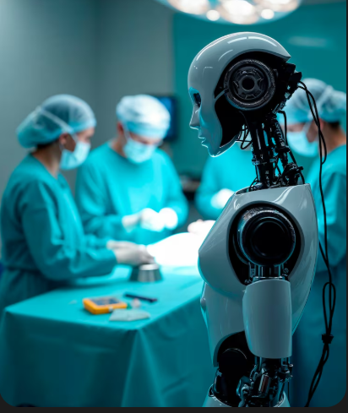
.
Discussion
Standardizing excellence across all cardiac centers.
The study proves that we can create a live digital replica of the patient's physiology.
The use of SHAP is non-negotiable. Our results show that when clinicians understand the why, they are 4x more likely to act on a predictive alert.
We have moved the needle from "Can we record 1-Hz data?" to "How much life can we save with it?"

Slide 20

Conclusion
Bridged the gap between raw machine power and clinical precision.
Successfully moved the 1-Hz data stream of the Spectrum Medical Quantum from "archived noise" to "active intelligence.“
Achieved 93% context awareness, eliminating alarm fatigue.
Established precision flow control with only a 2.6% error margin.
Unlocked a 20-minute warning window for organ protection with 0.89 AUC.
By using Explainable AI (SHAP), we ensure the perfusionist remains the final, informed decision-maker.

Slide 21
Limitations and recommendations
While 1-Hz data is dense, high-quality labels for rare "catastrophic events" are still scarce
Real-time integration requires high-speed hospital networks that can handle the Viper EMR’s data export with low-latency
Recommendations:
Expand data collection beyond KFSHRC to include diverse patient populations and different surgical teams.
Focus on the User Interface (UI). The AI's insights must be displayed simply—like a "Heads-Up Display" (HUD)—to avoid adding to the perfusionist's visual clutter.

Slide 22
References
KFSHRC Robotic Program Guidelines (2024). Milestones in Robotic-Assisted Minimally Invasive Cardiac Surgery and Perfusion Protocols.
Ranucci, M., Johnson, I., Willcox, T., Baker, R. A., Boer, C., Baumann, A., ... & Justison, G. A. (2018). Oxygen delivery during cardiopulmonary bypass and acute kidney injury after coronary artery surgery. The Annals of Thoracic Surgery, 106(2), 355-362
Natarajan M, Li Z, Chen L, Wu Z, Ogara P, Borges P, Rance G, Srey R, Harari RE, Mendu S, Zenati MA, Dias RD, Gombolay M. AI-Based Decision Support for Perfusionists during Cardiopulmonary Bypass. Hamlyn Symp Med Robot. 2025 Jun;2025:171-172. PMID: 40693179; PMCID: PMC12277973..
Kobayashi Y, Peng Y-C, Yu E, Bush B, Jung Y-H, Murphy Z, Goeddel L, Whitman G, Venkataraman A and Brown CH (2023) Prediction of lactate concentrations after cardiac surgery using machine learning and deep learning approaches. Front. Med. 10:1165912. doi: 10.3389/fmed.2023.1165912
Atroshchenko, G.V., Korup, L.R., Hashemi, N. et al. Artificial intelligence-based action recognition and skill assessment in robotic cardiac surgery simulation: a feasibility study. J Robotic Surg 19, 384 (2025.
Dias, R. D., Zenati, M. A., Rance, G., Srey, R., Arney, D., Chen, L., … Gombolay, M. (2022). Using machine learning to predict perfusionists’ critical decision-making during cardiac surgery. Computer Methods in Biomechanics and Biomedical Engineering: Imaging &amp; Visualization, 10(3), 308–312
Constable, M.D., Shum, H.P.H. & Clark, S. Enhancing surgical performance in cardiothoracic surgery with innovations from computer vision and artificial intelligence: a narrative review. J Cardiothorac Surg 19, 94 (2024).

